Slide 1
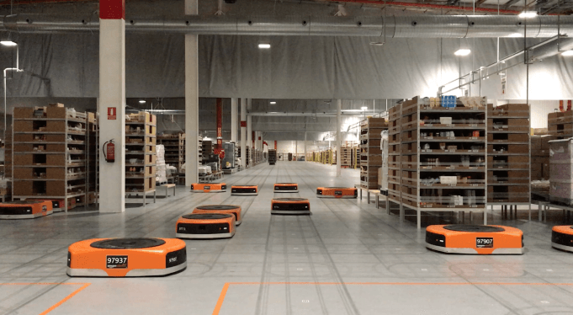
Amazon Robotics machines in a Amazon warehouse
Collision avoidance and coordination for a fleet of robots
Luca Marseglia

Slide 2
Summary
Understanding the best parameters in terms of population size and generations number
Analyzing convergence of the best fit history over different executions with the same parameters
2024 October | Slide 2

Slide 3
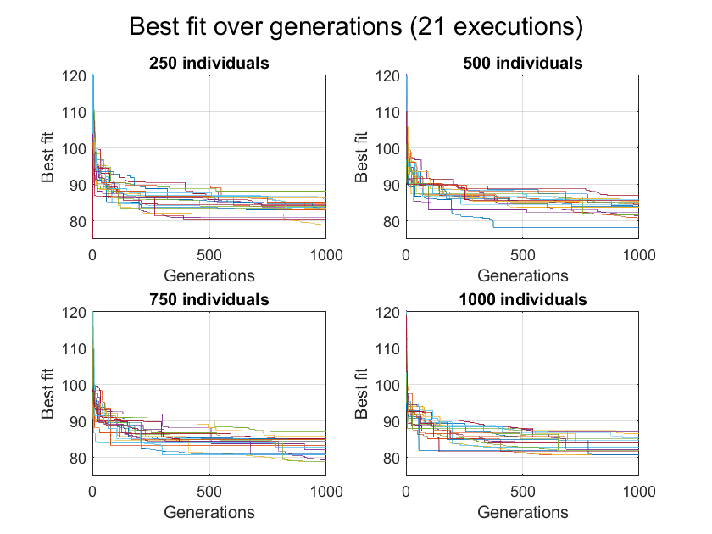
21 executions with 4 different population sizes
2024 October | Slide 3

Slide 4
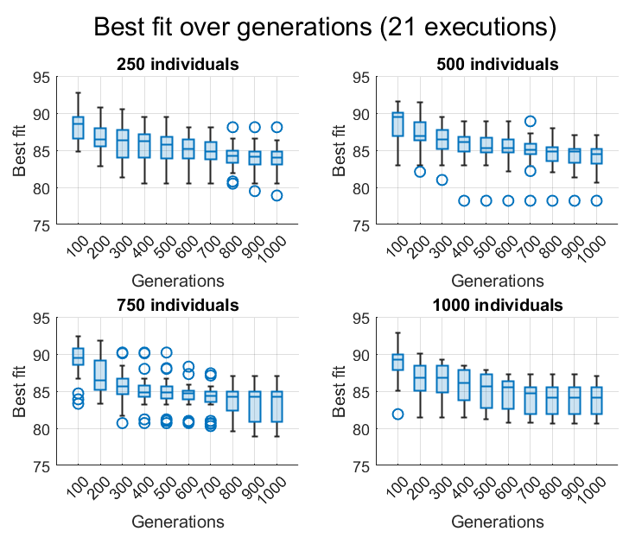
Box charts
2024 October | Slide 4

Slide 5
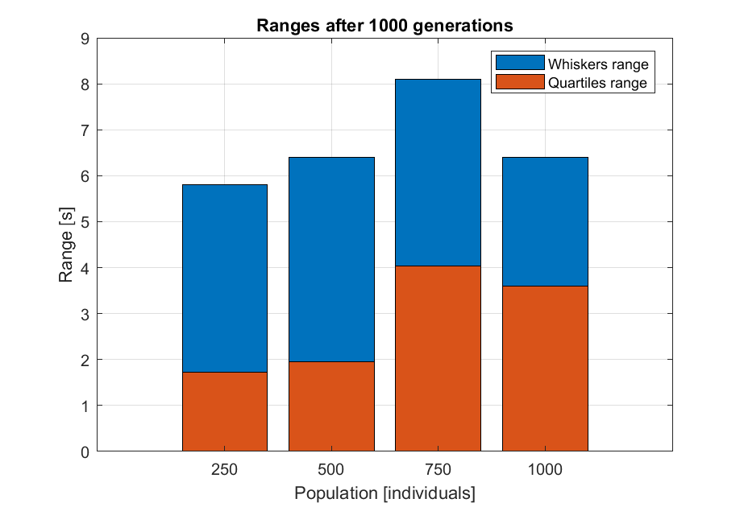
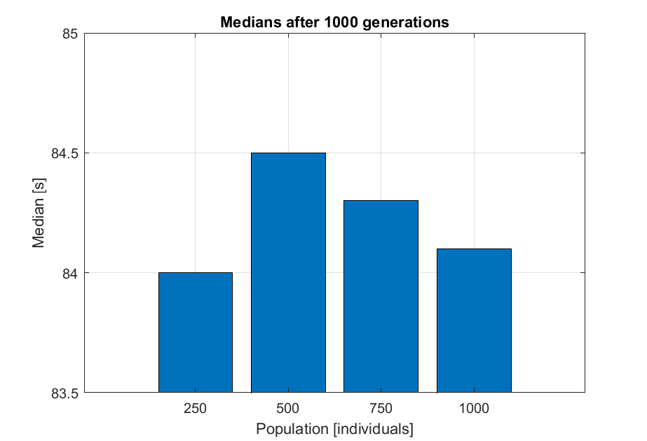
Box charts with 21 executions
2024 October | Slide 5

Slide 6
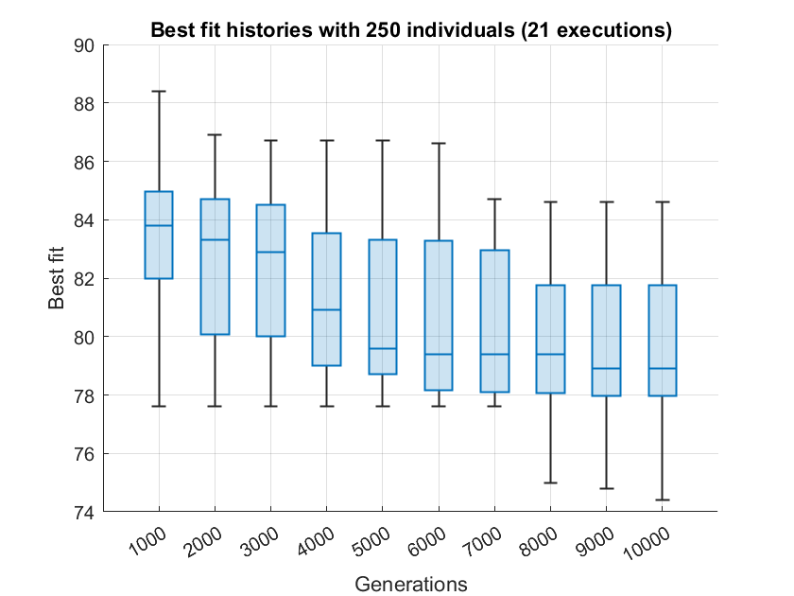
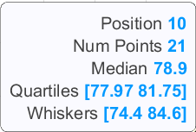
10.000 generations with 250 individuals
2024 October | Slide 6

Slide 7
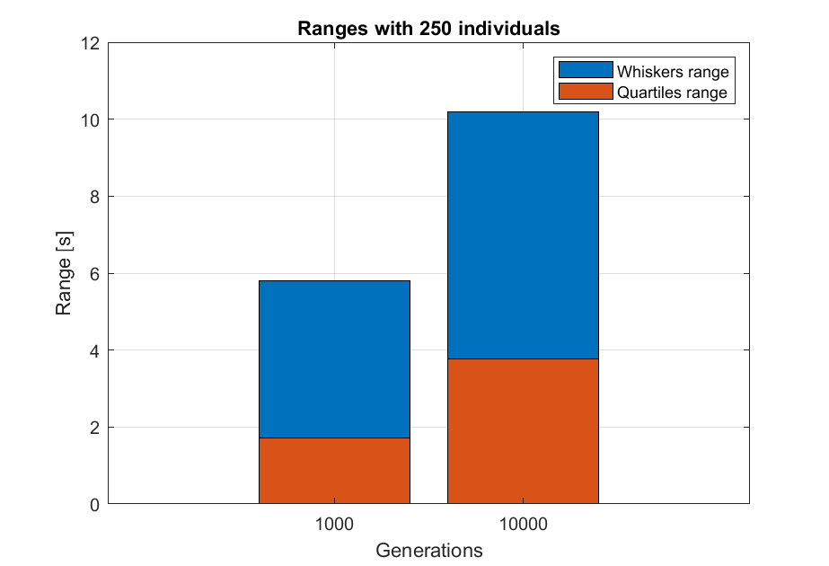
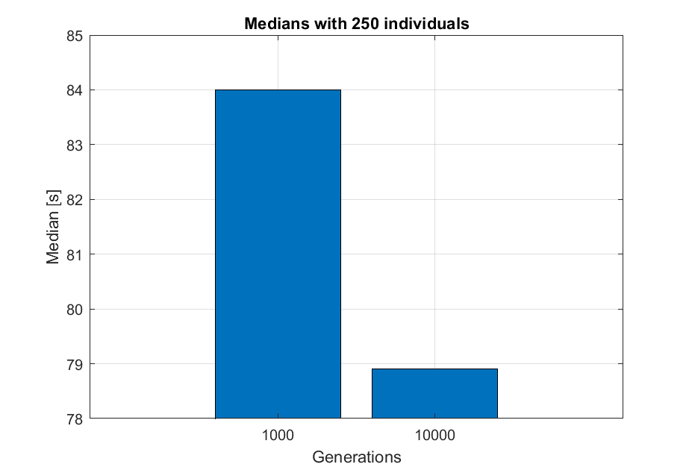
Box chart with 21 executions
2024 October | Slide 7

Slide 8
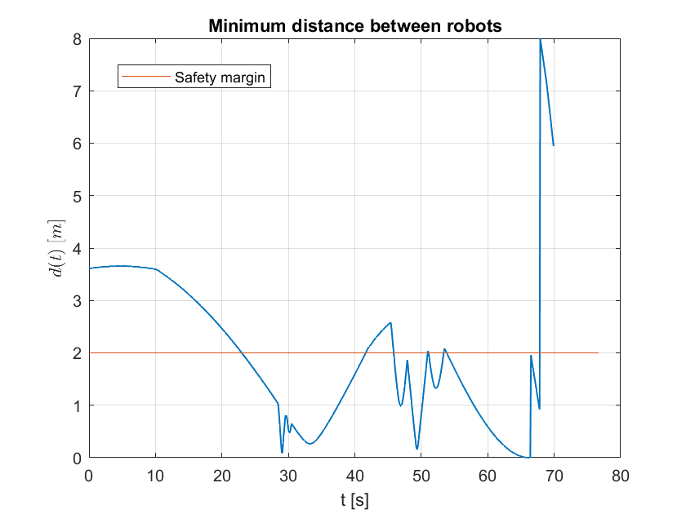
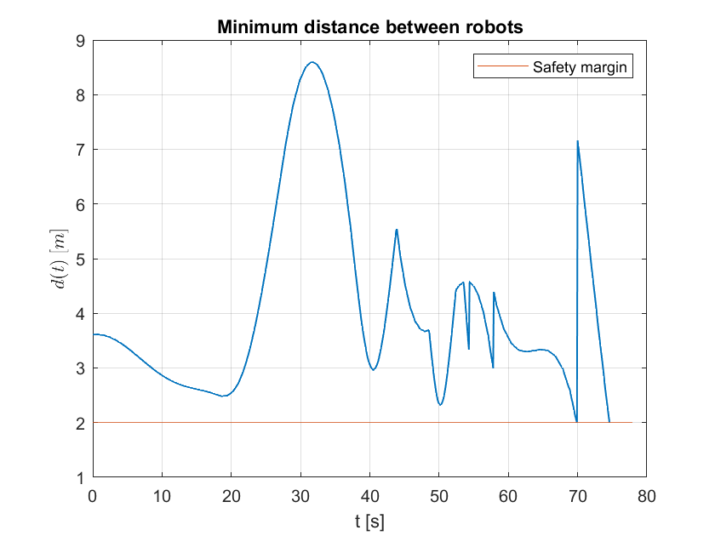
Results with 250 individuals and 10.000 generations
Before
After
2024 October | Slide 8

Slide 9
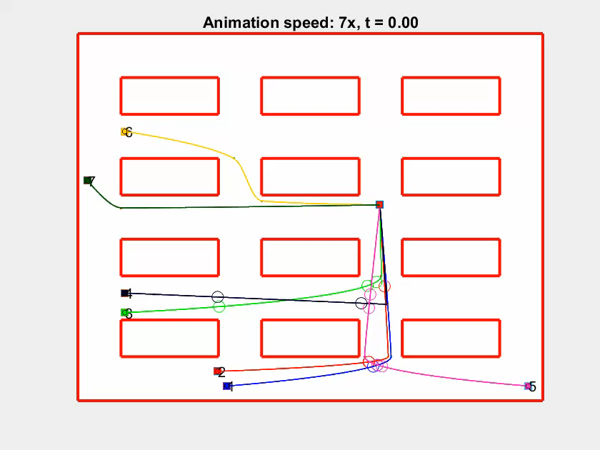
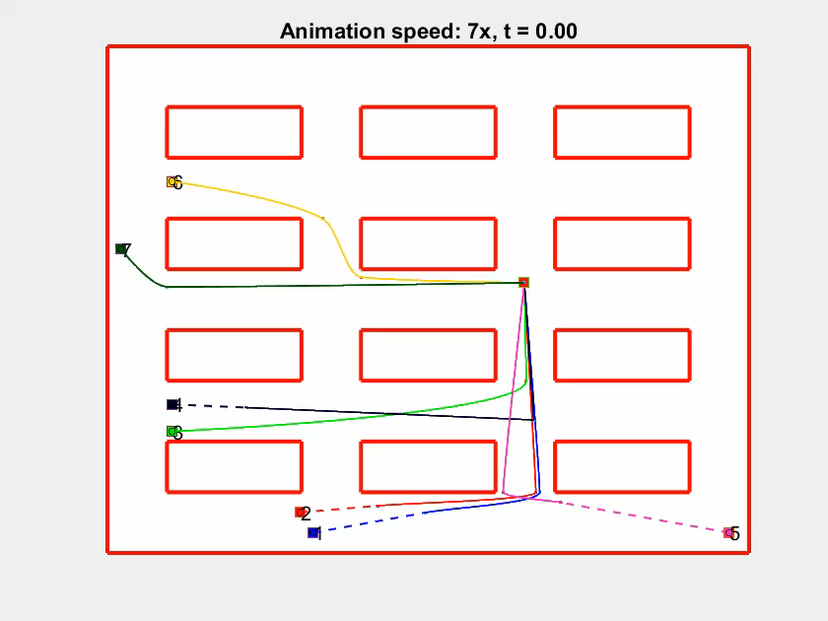
Results: 76.80 vs 77.90
Before
After
2024 October | Slide 9

